Slide 1
Microservices and DevOps
DevOps and Container Technology
DevOps
Henrik Bærbak Christensen

Slide 2
Expert People
From 2015 Master of IT thesis
“A typical development team includes UI designers/developers, backend developers, and database experts. […] and many other companies split the development process into several components, such as UI, backend, database and mobile applications.”
Why does this make sense?
UI designers
Application Server developers
Database designers
Boundaries between people ☹

Slide 3
Moving Code
Crossing the boundaries of environments for the full development-testing-deployment cycle is costly…
Reconfigurations
Setup
Changed architecture
Changed HW
Even worse
Different people
Someone else’s problem
Development Environment
Staging Environment
Production Environment
Boundaries between environments ☹

Slide 4
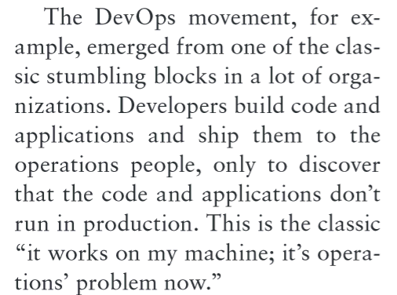
So
The problems
Boundaries between people
Is it the fault of the UI guys, or the DB guys
Boundaries between environments
But it works on my machine ???

Slide 5
Definition (?)
Key Points
Quality (of code) is important. ”Suitability” is key quality
Bass, Weber, Zhu, ”DevOps”, 2015
https://agilemanifesto.org/principles.html

Slide 6
Definition (?)
Key Points
High quality delivery mechanism – tooling to put change in prod.
Practices
Ops is first-class citizen
Logging and monitoring coded as part of Dev
Dev also involved in incident handling
Dev is usually responsible for initial deployment & monitoring

Slide 7
Definition (?)
Practices
Enforce deployment process
No ad-hoc stuff here… Automation is the name of the game.
Continuous delivery
Infrastructure-as-code

Slide 8
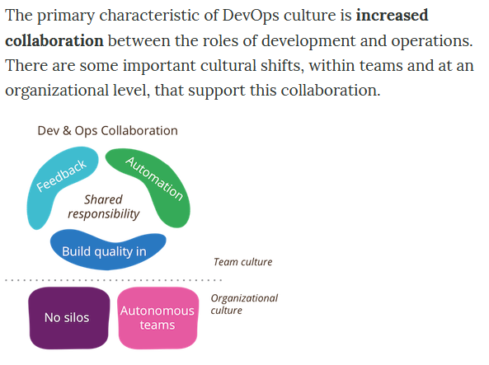
Other Defs
Wikipedia

Slide 9
DevOps Helps to
… ensuring that…
Boundaries between people
Is it the fault of the UI guys, or the DB guys?
Boundaries between environments
But it works on my machine?
The same people:
small DevOps teams
The ‘same’ environment:
small containers
Microservices: About getting the right containers...

Slide 10
Discussion
Have anyone experience
Organizing in DevOps
Pro/cons

